Slide 1
The Challenge Dashboard
 | Your Topical Discussion Question…
Your Weekly “Mockbridge” Question… | Your Weekly Fermi Question… | Don’t forget the Daily Challenges… Monday Tuesday Wednesday Thursday Friday
Does online gaming need to be more closely controlled by the Government?
Think Link!
To what extent is the first job of government to preserve individual freedom?
How many Fortnite users are there worldwide?
The Answer!

Slide 2
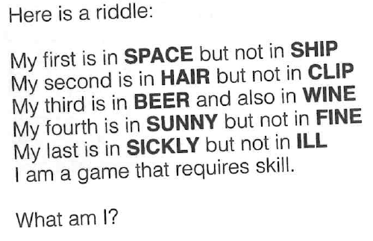
The Daily Challenge MONDAY
A Daily Dose of…
Do you want more challenge?
Why not try Radio 4’s “Puzzle for Today” by clicking on this link…

Slide 3
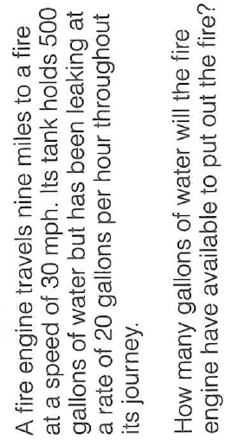
The Daily Challenge TUESDAY
A Daily Dose of…
Do you want more challenge?
Why not try Radio 4’s “Puzzle for Today” by clicking on this link…

Slide 4
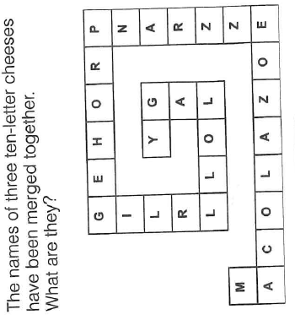
The Daily Challenge WEDNESDAY
A Daily Dose of…
Do you want more challenge?
Why not try Radio 4’s “Puzzle for Today” by clicking on this link…

Slide 5
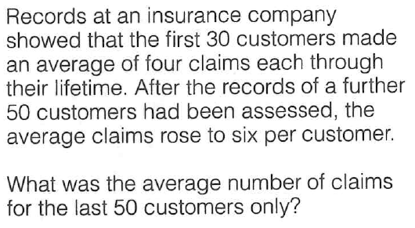
The Daily Challenge THURSDAY
A Daily Dose of…
Do you want more challenge?
Why not try Radio 4’s “Puzzle for Today” by clicking on this link…

Slide 6
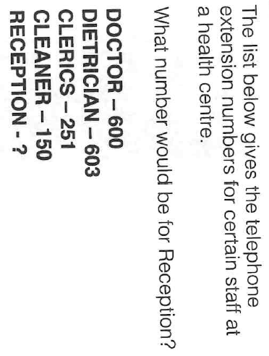
The Daily Challenge FRIDAY
A Daily Dose of…
Do you want more challenge?
Why not try Radio 4’s “Puzzle for Today” by clicking on this link…

Slide 7
Answers
Monday: Chess
Tuesday: 494
Wednesday: Mozzarella – Gorgonzola – Caerphilly
Thursday: 7.2
Friday: 101 – Roman numerals in each word totalled to give number

Slide 8
Fermi Question Answer…
250 million Fortnite players in total (March 2019)
https://www.businessofapps.com/data/fortnite-statistics/
Back to dashboard…

