Slide 1
The Challenge Dashboard
 | Your Topical Discussion Question…
Your Weekly “Mockbridge” Question… | Your Weekly Fermi Question… | Don’t forget the Daily Challenges… Monday Tuesday Wednesday Thursday Friday
Is the London-wide ban on Extinction Rebellion protests justified?
Think Link 1 – Think Link 2
Why are big, fierce animals so rare?
How many people were arrested during Exintction Rebellion’s protests in London in April 2019?
The Answer!

Slide 2
The Daily Challenge MONDAY
A Daily Dose of…
Do you want more challenge?
Why not try Radio 4’s “Puzzle for Today” by clicking on this link…

Slide 3
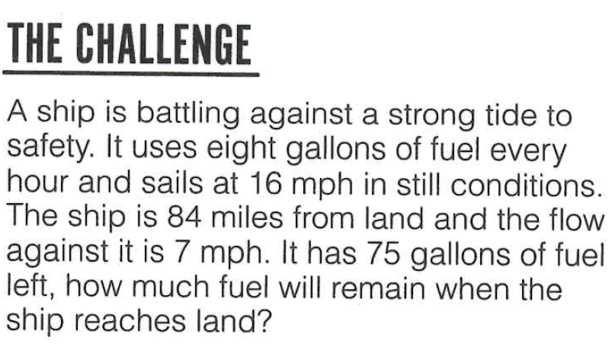
The Daily Challenge TUESDAY
A Daily Dose of…
Do you want more challenge?
Why not try Radio 4’s “Puzzle for Today” by clicking on this link…

Slide 4
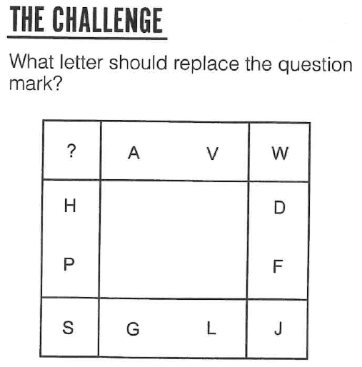
The Daily Challenge WEDNESDAY
A Daily Dose of…
Do you want more challenge?
Why not try Radio 4’s “Puzzle for Today” by clicking on this link…

Slide 5
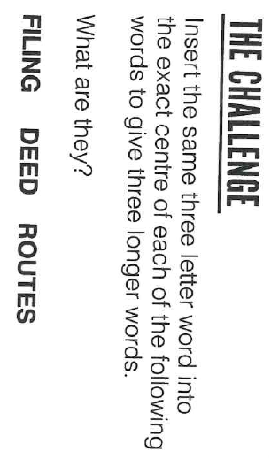
The Daily Challenge THURSDAY
A Daily Dose of…
Do you want more challenge?
Why not try Radio 4’s “Puzzle for Today” by clicking on this link…

Slide 6
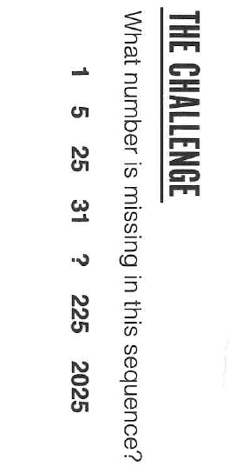
The Daily Challenge FRIDAY
A Daily Dose of…
Do you want more challenge?
Why not try Radio 4’s “Puzzle for Today” by clicking on this link…

Slide 7
Answers
Monday: Easier said than done.
Tuesday: One third of a tank.
Wednesday: X – The Alphabetical positions of the two letters along each edge are added together to give the alphabetical value of the corner letter.
Thursday: Filleting – Deleted Roulettes
Friday: 217 (+4, x5, +6, x7, +8, x9)

Slide 8
Fermi Question Answer…
1,130people arrested over April's London protests…
https://www.bbc.co.uk/news/uk-48607989
Back to dashboard…

