Slide 1
The Challenge Dashboard
 | Your Topical Discussion Question…
Your Weekly “Mockbridge” Question… | Your Weekly Fermi Question… | Don’t forget the Daily Challenges… Monday Tuesday Wednesday Thursday Friday
Is mental health now as easy to talk about as physical health?
Think Link!
Does a healthy body always mean a healthy mind?
How many people in the UK will experience a mental health problem each year?
The Answer!

Slide 2
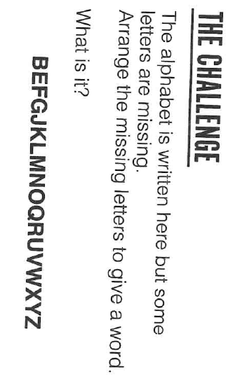
The Daily Challenge MONDAY
A Daily Dose of…
Do you want more challenge?
Why not try Radio 4’s “Puzzle for Today” by clicking on this link…

Slide 3
The Daily Challenge TUESDAY
A Daily Dose of…
Do you want more challenge?
Why not try Radio 4’s “Puzzle for Today” by clicking on this link…

Slide 4
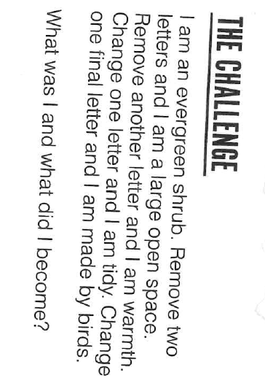
The Daily Challenge WEDNESDAY
A Daily Dose of…
Do you want more challenge?
Why not try Radio 4’s “Puzzle for Today” by clicking on this link…

Slide 5
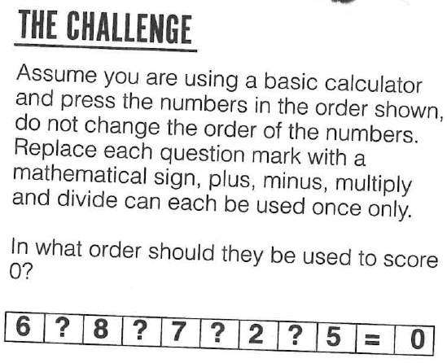
The Daily Challenge THURSDAY
A Daily Dose of…
Do you want more challenge?
Why not try Radio 4’s “Puzzle for Today” by clicking on this link…

Slide 6
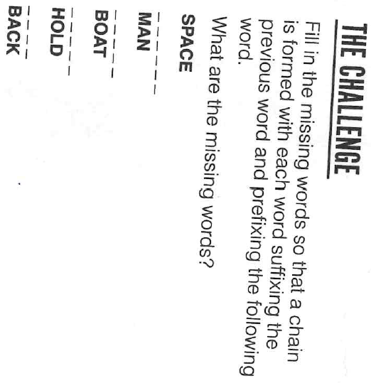
The Daily Challenge FRIDAY
A Daily Dose of…
Do you want more challenge?
Why not try Radio 4’s “Puzzle for Today” by clicking on this link…

Slide 7
Answers
Monday: Dispatch
Tuesday: 3 miles east
Wednesday: Heather – Heath – Heat – Neat – Nest
Thursday: + ÷ - x
Friday: Craft – Power – House – Fast

Slide 8
Fermi Question Answer…
1 in 4 (i.e. approximately 16.5million)
https://www.mind.org.uk/information-support/types-of-mental-health-problems/statistics-and-facts-about-mental-health/how-common-are-mental-health-problems/#.XZ7-PEbds2w
Back to dashboard…

