Slide 1
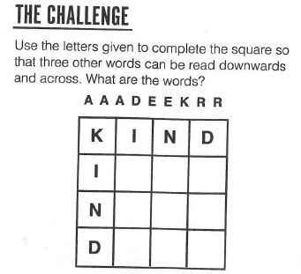
The Daily Challenge MONDAY
A Daily Dose of…
Do you want more challenge?
Why not try Radio 4’s “Puzzle for Today” by clicking on this link…

Slide 2
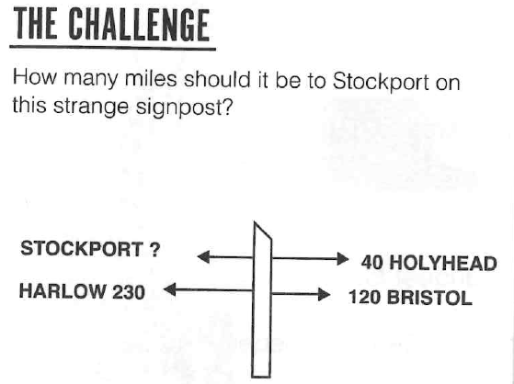
The Daily Challenge TUESDAY
A Daily Dose of…
Do you want more challenge?
Why not try Radio 4’s “Puzzle for Today” by clicking on this link…

Slide 3
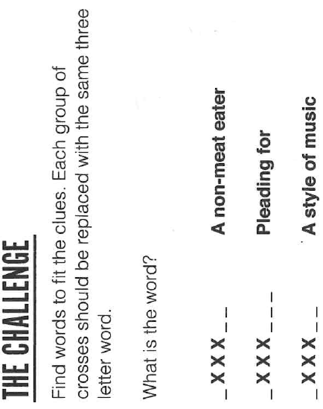
The Daily Challenge WEDNESDAY
A Daily Dose of…
Do you want more challenge?
Why not try Radio 4’s “Puzzle for Today” by clicking on this link…

Slide 4
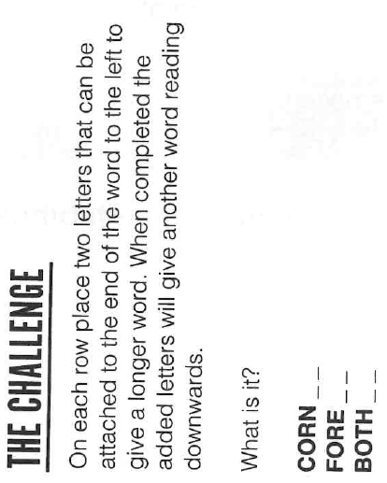
The Daily Challenge THURSDAY
A Daily Dose of…
Do you want more challenge?
Why not try Radio 4’s “Puzzle for Today” by clicking on this link…

Slide 5
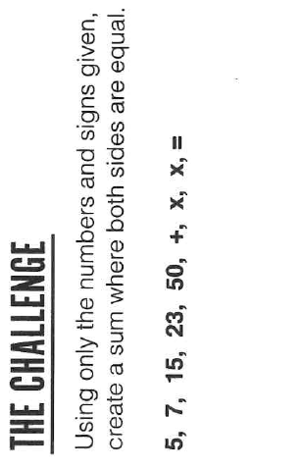
The Daily Challenge FRIDAY
A Daily Dose of…
Do you want more challenge?
Why not try Radio 4’s “Puzzle for Today” by clicking on this link…

Slide 6
Answers
Monday: Idea, near, dark
Tuesday: 200 (The alphabetical value of the last letter is multiplied by 10)
Wednesday: EGG to give veggie, begging and reggae
Thursday: Easter
Friday: (15 x 23) + 5 = 7 x 50

Slide 7
Fermi Question Answer…
100 million
https://www.businessinsider.com/amazon-reveals-alexa-sales-2019-1?r=US&IR=T
Back to dashboard…

