Slide 1
REDUCING OUR SCHOOL’S NEGATIVE IMPACT ON THE ENVIRONMENT
Parkstone grammar school
Notes:
DANIELLA- Welcome to Parkstone Grammar’s solution to the challenge of reducing our School’s negative impact on the environment

Slide 2
THE Main culprits
HUGE USAGE OF ELECTRICITY - LIGHTS in classrooms / COMPUTER SERVERS
HUGE VOLUMES PRINTING
HUGE VOLUMES OF PAPER USED UNECESSARILY
LITTER
SINGLE-USE PLASTICS - PENS, LUNCHES & WATERBOTTLES
LACK OF KNOWLEDGE/ EDUCATION ABOUT LIVING MORE SUSTAINABLY
WASTED RESOURCES- PAINTS/ PLASTIC FOLDERS
LACK OF RECYCLING BINS/ OPPORTUNITIES
MISSED OPPORTUNITIES TO ADD POSITIVE ENVIRONMENTAL IMPACT- FUNDRAISING FOR CHARITIES, STUDENT VOLUNTEERS/CLUBS etc.
Notes:
DANIELLA: In our research we found that the main culprits are: use of electricity; printing; paper; litter; single-use plastics; lack of knowledge; waste, lack of recycling & lack of opportunities to make a positive impact

Slide 3
Department for education sustainability & climate change strategy 2022
‘DfE has an important role to play in all aspects of sustainability. But the area in which we have the most work to do is reducing our environmental footprint, particularly in the drive to achieve net zero.’
‘The challenge of climate change is formidable. For children and young people to meet it with determination, and not with despair, we must offer them not just truth, but also hope. Learners need to know the truth about climate change – through knowledge-rich education. They must also be given the hope that they can be agents of change, through hands-on activity and, as they progress, through guidance and programmes allowing them to pursue a green career pathway in their chosen field’
Through education we have the privilege to be able to engage directly with children and young people who:
-are passionate about the natural world
-want to do their best to protect it
-can influence their wider communities – in a school of only 400 students, the potential reach could be as much as 2,500 people!
Notes:
DANIELLA- the Department for Education released a strategy in 2022 directly regarding the importance that School’s and education can plan in sustainability & climate change.
They stated that: ‘The challenge of climate change is formidable. For children and young people to meet it with determination, and not with despair, we must offer them not just truth, but also hope.’
Our response to this challenge has been informed by their strategy of educating and empowering individuals, and particularly young people, to make the difference!

Slide 4

We are going to require The School, its staff and ITS students, to electronically sign a PLEDGE that they will do whatever is in their power to ensure that they and their school have as little negative impact on the environment as possible.
Notes:
LOLA: We are going to require The School, its staff and ITS students, to electronically sign a PLEDGE
that they will do whatever is in their power to ensure that they and their school have as little negative impact on the environment as possible.

Slide 5
SCHOOL STUDENT PLEDGE:
As a student of Parkstone Grammar School I pledge to:
PICK UP LITTER around school when I see it- even if it’s not mine;
Use the RECYCLING BINS whenever relevant;
Use the PEN GRAVEYARDS in all the tutor bases and classrooms around School
Only use RE-USABLE WATER CANTEENS strictly no plastic bottles in School!
Wherever possible, NOT BUY SINGLE USE PLASTICS when I bring my lunches into School
Try NOT TO WASTE MATERIALS/ RESOURCES or use more then I need e.g. paints in Art or blue tissue when cleaning up
Notes:
LOLA:
The student pledge asks students to..
PICK UP LITTER around school
Use the RECYCLING BINS
Use the PEN GRAVEYARDS
Only use RE-USABLE WATER CANTEENS
Wherever possible, NOT BUY SINGLE USE PLASTICS
Try NOT TO WASTE MATERIALS/ RESOURCES

Slide 6
SCHOOL STAFF PLEDGE:
As a member of staff of Parkstone Grammar School I pledge to:
TURN LIGHTS OFF when leaving classrooms;
Consciously attempt to REDUCE PAPER PRINTING VOLUME both by printing 2 pages onto 1 sheet wherever possible, and by USING ONLINE ELECTRONIC FORMATS OF SHARING INFORMATION & WORKSHEETS with students, as opposed to printing off reams of paper;
Use FILES/FOLDERS from Year 7 instead of exercise books into which students are asked to stick paper onto paper!?;
PICK UP LITTER around school when I see it- even if it’s not mine;
Use the RECYCLING BINS whenever relevant;
Use the PEN GRAVEYARDS in all the tutor bases and classrooms around School
only use RE-USABLE WATER CANTEENS strictly no plastic bottles in School!
Wherever possible NOT BUY SINGLE USE PLASTICS when I bring my lunches into School
Train & empower my students to keep WASTAGE OF RESOURCES to a minimum
Notes:
LOLA:
The staff pledge is similar with the addition of:
TURN LIGHTS OFF when leaving classrooms;
attempt to REDUCE PAPER PRINTING VOLUME and USE ONLINE ELECTRONIC FORMATS OF SHARING INFORMATION & WORKSHEETS wherever possible
Use FILES/FOLDERS from Year 7 instead of exercise books

Slide 7
SCHOOL PLEDGE:
Parkstone Grammar School pledges to:
Commit to creation of an ECO TEAM CLUB and support it’s work, which would include:
weekly litter picks;
creating and regularly emptying pen graveyards;
educating the school through assemblies;
running fundraising activities such as clothes swaps or non-uniform days;
putting up bird boxes and more!
Commit to creation of a GARDENING CLUB and support the use of compost bins for food waste from both kitchen staff and students’ own lunches
Find time within the curriculum (possibly during PSHE/Tutor time/ or Well-being lessons) to include our ‘Education to become sustainable now and beyond school’ SCHEME OF LESSONS. (further detail to follow- nb. 1)
Following on from this, to commit tutor times at the end of the Summer Term to ask each student to prepare a power point presentation that shows
what they have done as an individual within the school community to help reduce their impact on the environment over the school year–
everyone who completes a relevant presentation gets a reward/ badge etc?
To commit to create a monthly Environmental NEWSLETTER that is circulated electronically to share opportunities to help out the environment
(example to follow- nb. 2)
To instruct the CANTEEN to reduce and ideally completely stop the use of single use plastics and offer more vegan options;
To hire-purchase, for every student in the school, an IPAD OR LAPTOP that parents pay a weekly sum for, which slowly pays off the overall cost and allows the student to keep the laptop at the end of their time in the school- this will reduce the huge waste of electricity and hardware that the current IT system creates.
to add ENVIRONMENTAL ACHIEVEMENT POINTS onto SIMS so that students can earn points when they do an act that helps protect the environment
Notes:
BELLA:
The School Pledge would ask the school to commit to:
Commit to creation of an ECO TEAM CLUB and support it’s work,
Commit to creation of a GARDENING CLUB and support the use of compost bins for food waste
Find time within the curriculum to include our ‘Education to become sustainable now and beyond school’ SCHEME OF LESSONS.
Commit tutor times at the end of the Summer Term for student presentations that show what they have done as an individual within the school community to help reduce their impact on the environment over the school year
Commit to create a monthly Environmental NEWSLETTER that is circulated electronically to share opportunities to help out the environment
Instruct the CANTEEN to reduce and ideally completely stop the use of single use plastics and offer more vegan options;
to add ENVIRONMENTAL ACHIEVEMENT POINTS onto SIMS so that students can earn points when they do an act that helps protect the environment

Slide 8
1-A SCHEME OF WORK TO FOSTER SUSTAINABILITY SKILLS beyond school
As of 2021, the statutory guidance given to all secondary schools makes it a requirement to teach health and wellbeing education.
The guidance states:
“To embrace the challenges of creating a happy and successful adult life, pupils need knowledge that will enable them to make informed decisions about their wellbeing, health and relationships and to build their self-efficacy. Pupils can also put this knowledge into practice as they develop the capacity to make sound decisions when facing risks, challenges and complex contexts. “
This guidance can link very closely to climate education as when we look at the key fundamentals of the solutions to the climate crisis, it is on an extremely individual level, with a focus on our consumption and footprints within society. Ultimately, schools are the key to prospering this education to allow the next generation to build a toolkit of resources and skills to live more ethically and sustainably in everyday life which is a key feature missing to our curriculum.
Notes:
BELLA:
Not only did the Department for Education legally require Schools to become sustainable in 2022, in 2021 the Government required all Schools to teach health & well being education. Ultimately the key fundamentals of the solutions to the climate crisis, on an individual level, requires a focus on our consumption and footprints within society. Ultimately, schools are key to prospering this education to allow the next generation to build a toolkit of resources and skills to live more ethically and sustainably in everyday life.

Slide 9

Environmental Anxiety
https://xryouth.uk/about/
https://www.theguardian.com/society/2021/oct/06/eco-anxiety-fear-of-environmental-doom-weighs-on-young-people
A 2020 survey of child psychiatrists in England showing that more than half (57%) are seeing children and young people distressed about the climate crisis and the state of the environment. Alongside this, a recent international survey of climate anxiety in young people aged 16 to 25 showed that the psychological burdens of climate crisis were “profoundly affecting huge numbers of these young people around the world”.
Environmental anxiety is evidently a serious issue affecting school age children and young adults – it is clear there is not enough action being taken and is therefore burdening the ultimate generation who will have to deal with the consequences – millennials, generation Z and the alpha generation. Through school – based workshops such as ‘Make do and Mend’ as well as Nutrition workshops, there is direct contact with these students, and will therefore help alleviate fears and make them much more equipped.
Additionally, there is evidence that there is a clear audience who are ready to engage with these education schemes.
Notes:
JAS:
Furthermore this action and education could go some way to reducing the effect of ‘Environmental Anxiety’ which is a growing issue amongst young people today.
We would want to design a scheme of work that could be provided through schools to educate young people and give them the power to live more sustainably.. This might include…

Slide 10
‘Make do and mend’
According to the UN, the fashion industry is responsible for 8-10% of global emissions yet still global clothes sales could increase by up to 65% by 2030, the World Bank suggests. This highlights a serious issue we have with our overconsumption of clothing as the lifetimes of our clothes diminish. Especially within Generation Z, the skill to make and mend clothes is extremely rare yet extremely detrimental to improve the longevity of our purchases, preventing clothing from going to landfill as well as stopping our consumption of fast fashion items. These make do and mend sessions can be implemented into the current textiles curriculum as well as additional sessions through clubs and top – ups to make sure this vital skill is accessible to everyone.
HOW? – These sessions could be focused on bringing in personal items that need to be mended to limit consumption of new materials by reusing and recycling what we already have. Additionally, there could be the option to work together in groups to focus on the creation of items for around school, such as maybe a project to make costumes for a drama project or school play. Teaching can be extremely mixed whether through volunteer teaching staff, student led workshops or even working with local organisations. For BCP, this may include inviting current AUB students studying fashion to come in and run some help sessions.
https://www.bbc.co.uk/news/science-environment-60382624
Notes:
JAS:
‘Make do & Mend’ where students could bring in personal items that need to be mended to limit consumption of new materials by reusing and recycling what we already have. This could be run through volunteer staff or perhaps in collaboration with the fashion and textiles degree students from Arts University Bournemouth who could come in and lead sessions.

Slide 11
‘Eating sustainably’
Having classes and workshops available for all young people within schools to look at what eating sustainably looks like, whilst also maintaining a nutritious, balanced diet. These sessions could build on information about how to get enough protein in a vegan diet, how to limit energy consumption when cooking meals or ideas of how to share resources and food with people to live more ethically. This could be through moving away from using meats and heavily processed foods to the stretch of looking at food miles, and how we can move our consumerism to more local produce to save our CO2 emissions etc.
HOW? – Through sessions, there could be ranges of theory lessons that go through the basics of nutrition alongside practical sessions when students practice cooking for themselves using recipes they’ve found. Teaching for this could be mixed through already existing food tech staff as well as other students who may be able to share knowledge on what they understand, to create a community in schools of students who are all learning a key life skill – how to sustain themselves and the planet. On a more long-term basis, these students may work towards a goal together such as ‘Come Dine with Me’ schools edition in order to maximise engagement between pupils.
https://www.bbcgoodfood.com/recipes/collection/vegan-student-recipes
Notes:
DANIELLA:
‘How to Eat Sustainably’ – theory lessons that go through the basics of nutrition and information about eating & cooking sustainably alongside practical sessions when students practice cooking for themselves using recipes they’ve found, to create a community in schools of students who are all how to sustain themselves AND the planet. On a more long-term basis, these students may work towards a goal together such as ‘Come Dine with Me’ schools edition in order to maximise engagement between pupils.

Slide 12
‘Reducing energy consumption’
Due to the cost of living crisis and rising energy bills, that around 18 million people will pay an extra £1,578 a year on their energy bills - from £1,971 to 3,549 per year - an increase of 80%. This will affect everyone in varying different ways through the energy used in heating, cooking and lighting. Reducing our energy consumption is a key factor to move forward in our everyday lives to not only save our wallets but to also save our planet. Many renewable energy resources are now emerging such as solar and wind power, but the majority of our energy relies on finite resources such as coal and oil so every limit makes a difference!
HOW? – Within PHSE/ Time 2 Talk sessions, when looking at saving and budgeting, incorporate a focus within sessions of how to limit consumption on a daily basis by cooking more energy efficient meals, or making sure all appliances are turned off fully, not left on standby, taking shorter showers etc. Additionally, this education could be incorporated within a school-wide drive by a force of sustainability to limit the overcharging of laptops, turning off lights in rooms not being used as well as all factors that feed into the daily operations.
https://www.ovoenergy.com/guides/energy-guides/how-to-save-electricity-at-home
Notes:
DANIELLA:
‘Reducing your energy consumption & living more sustainably’ classes- in today’s climate, these would be useful for everyone… both for environmental AND financial reasons! This could cover hints & tips for home such as making sure all appliances are turned off fully, not left on standby, taking shorter showers and also for School- such as not over charging laptops and turning lights off!

Slide 13
OTHER CLASSES COULD INCLUDE:
- ‘Growing your own Vegetables’
‘How to recycle properly’
And more!
A digital toolkit for students – students would log the classes and teaching sessions they have attended and write down summaries with instructions of what they learnt.
Then, when they need to utilise a skill they have learnt, they can check their toolkit & retrieve the history of their learning to help them (e.g. – a hole in a skirt = look at the toolkit and find the entry made 2 months ago from a ‘Make do and Mend’ lunchtime session you attended).
Alongside this, through creating entries, these students would be creating evidence and beginning to build their end of year ENVIRONMENTAL ACTION PRESENTATIONS for which they could gain badges.
Notes:
DANIELLA:
Other classes we could develop within the scheme could include ‘Growing your own Vegetables’ and ‘How to Recycle’.
We would ensure that students attending these classes would log their learning online and this would build them a digital toolkit of skills that they could refer back to when they needed to remind themselves.
As mentioned before, educating just our Parkstone students in these matters could empower them to spread this knowledge through parents, siblings & the local community and have a huge impact on our local area!

Slide 14

2-monthLY ENVIRONMENTal newsletter..
Notes:
JAS:
We plan to create a monthly Environmental Newsletter like the mock-up shown here, that will be accessible through our Environmental Action Webpage, that will celebrate any good work that Parkstone students have done to reduce negative Environmental impact and will also advertise monthly Eco opportunities to get involved with.

Slide 15
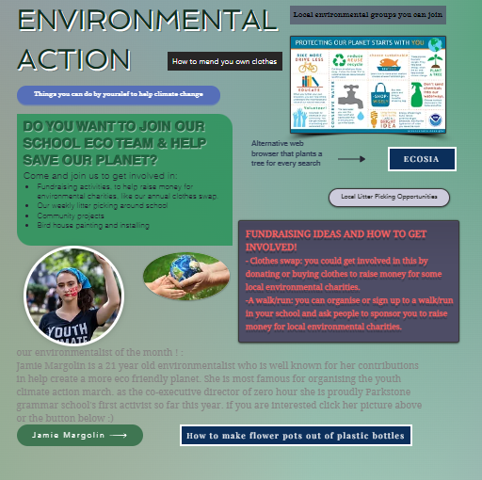
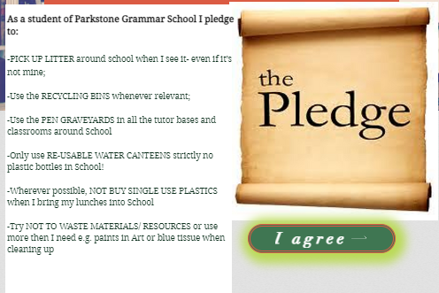
3-OUR ENVIRONMENTal action website..
https://editor.wix.com/html/editor/web/renderer/edit/82528390-5a0c-45d6-8226-e40eab8e8044?metaSiteId=800a9e7c-061a-4948-a8d3-906c965e2995
Notes:
BELLA:
The PLEDGE will be an electronic form that opens up when each member of staff, and each student, logs-in to their School computer ID for the first time each academic year, and they will need to electronically sign it at that time
Once signed, this will also open up access to our ENVIRONMENTAL ACTION WEBPAGE
Once students & staff have agreed to the pledge they would then be able to access our Environmental Action webpage- this will have lots of information on it, including links to:
Information on how to join the School Eco Team
Things you can do by yourself to help climate change
Local litter picking opportunities
Local environmental groups you can join
Our ‘Environmentalist of the Month’ monthly blog
Links to our Parkstone Grammar Twitter & Instagram sites
And more!

Slide 16
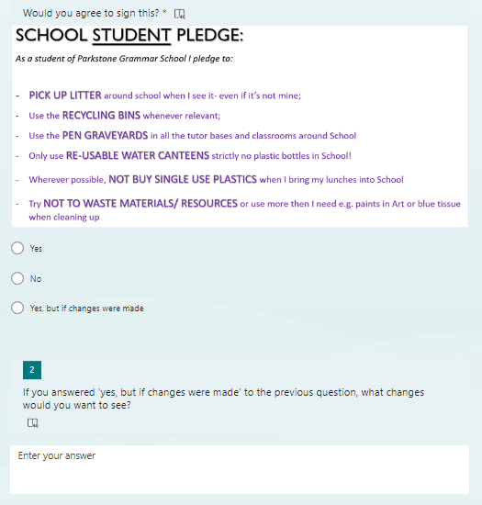
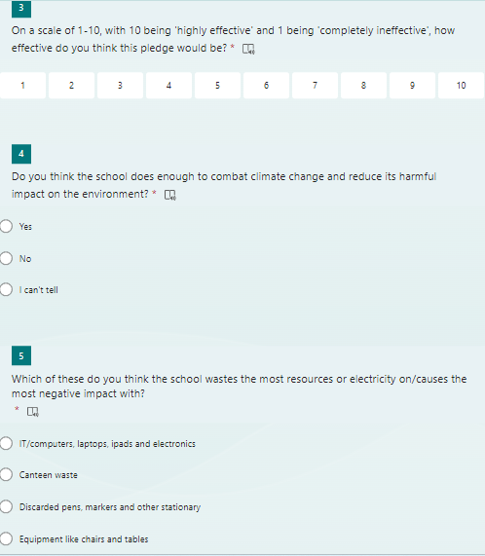
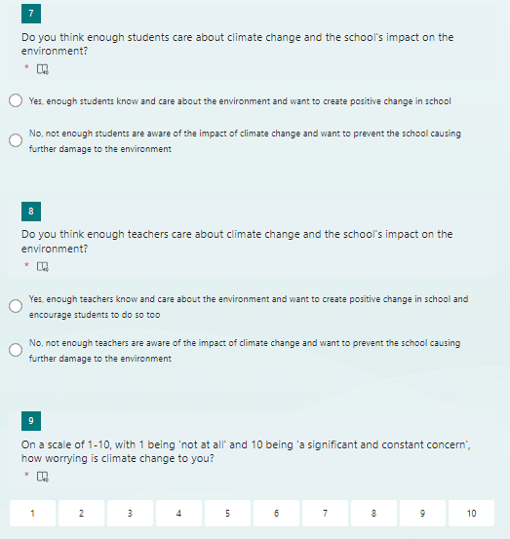
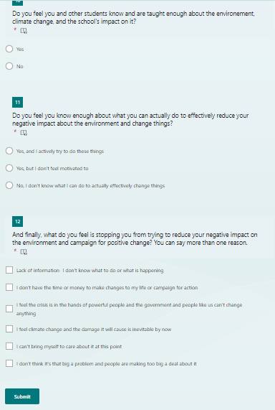
Staff & student surveys & results
Notes:
JAS:
To see if our idea was something that staff and students would be willing to signing the pledge, and to find out more staff & student views about their own, and Parkstone’s impact on the environment, we created a GOOGLE FORM SURVEY for staff and students to complete..

Slide 17
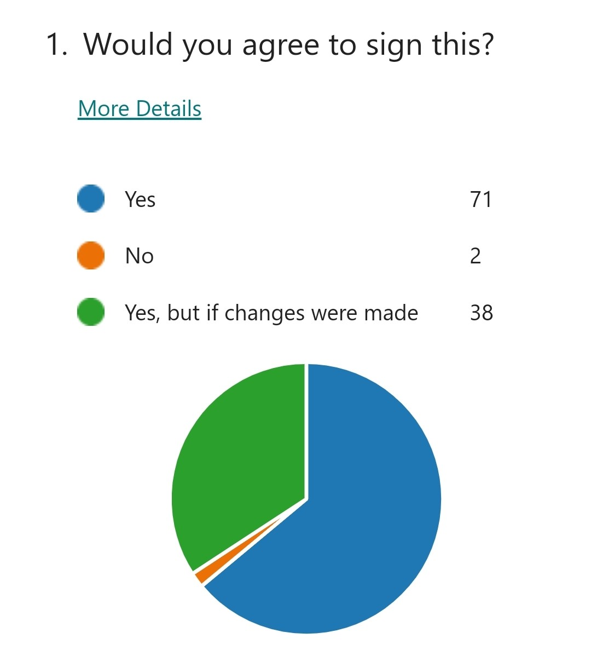
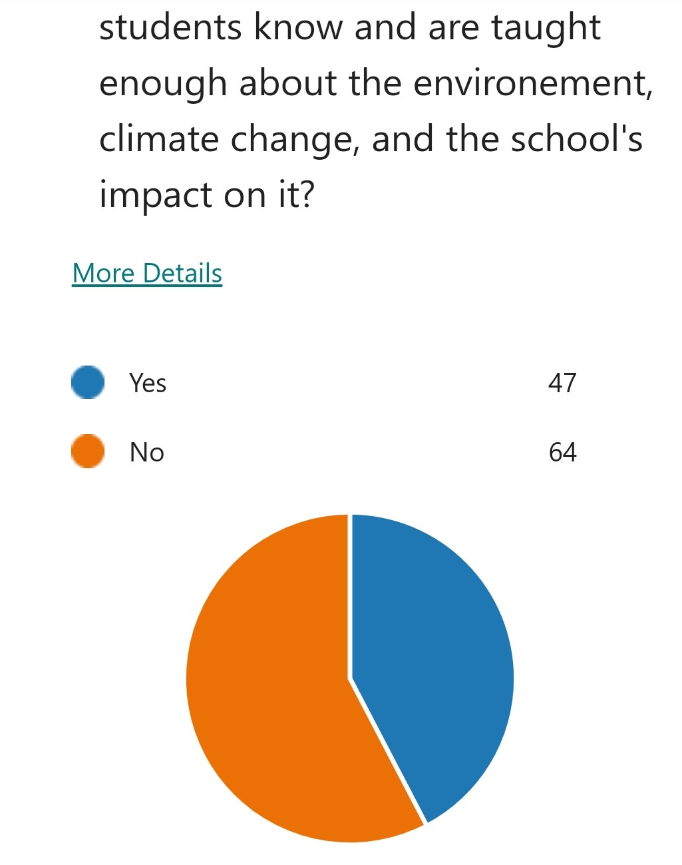
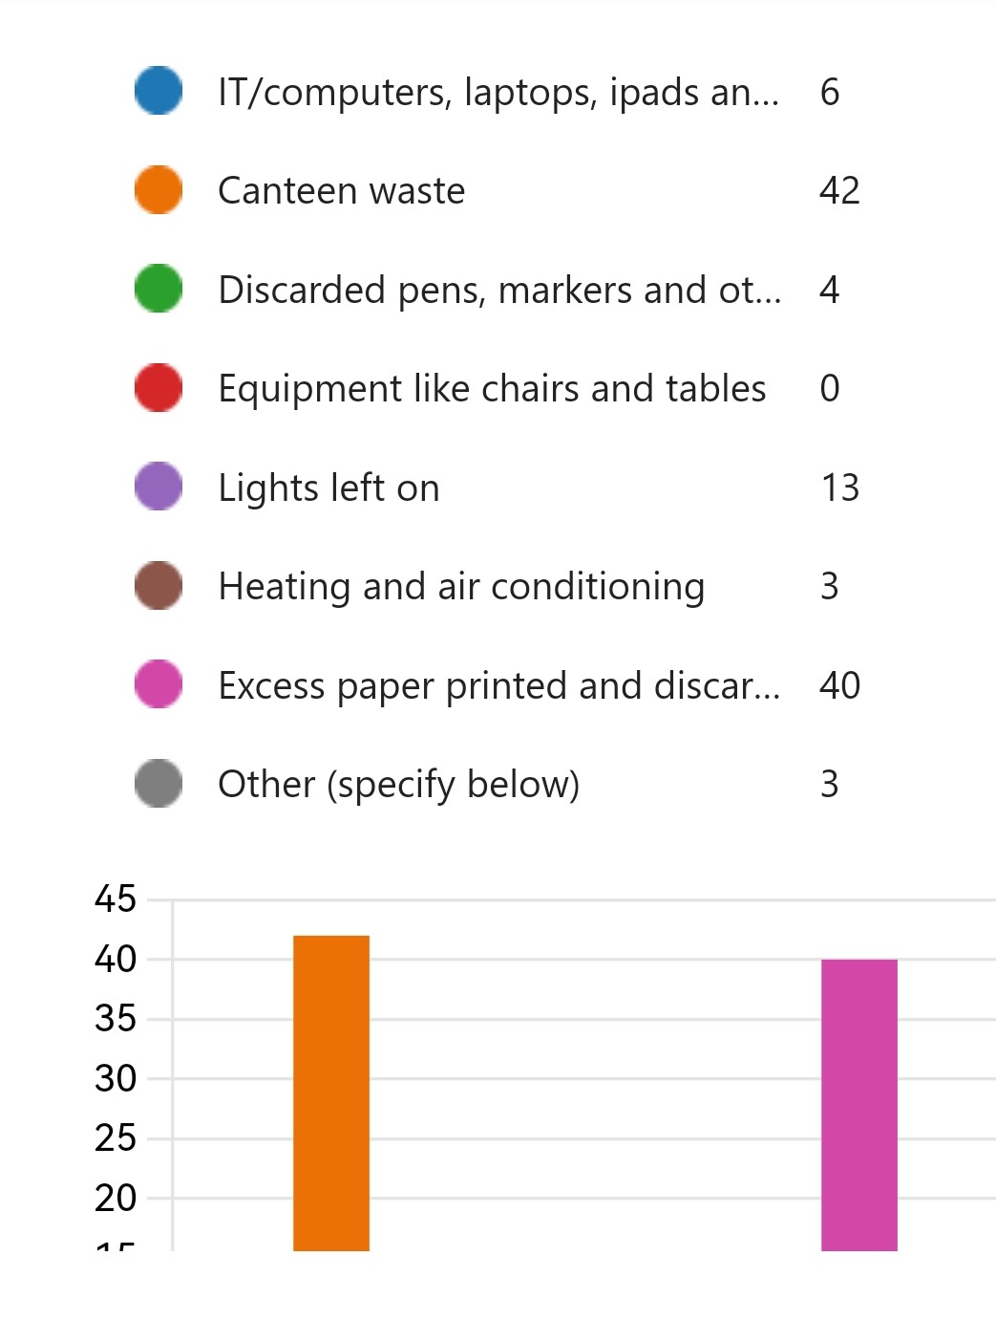
Staff & student surveys & results
OVERWHELMING SUPPORT for the pledge from both Teachers & Students in general!
Notes:
JAS:
The results found that there was OVERWHELMING SUPPORT for the pledge from both Teachers & Students in general!
We were also really thrilled with the statistics of students & staff that showed how much our School body wants to help the environment. When asked how worrying climate change was to them, only 1-2% rated it low whilst 71% rated their concern as ‘significant and constant’. It was interesting to note that the main obstacle noted to making changes was not knowing how to- this only adds to our conviction in the importance of educating our cohort through our Scheme of Work.
71% of those surveyed would sign the pledge, & others would if a few changes were made. Only 2% of those surveyed would not sign it. Suggested changes included:
Asking students & staff to try to reuse plastic water bottles before binning them OR use refillable water canteens
Picking litter up as soon as your friends drop it or not dropping it in the first place!
Requests for more bins clearly labelled and water dispensers
And requests to make pen graveyards more visible and have one in every classroom
All these suggestions we can action and adapt within our pledge and as a response to these results we decided we could use our £300 budget to source more BINS and more WATER DISPENSERS!

Slide 18
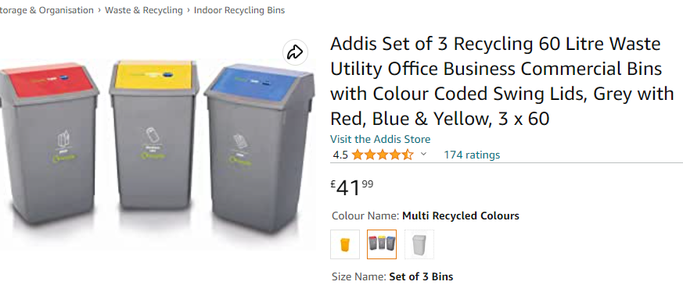
Budget plan
Notes:
LOLA:
We did some research and found that for £300 we could initially only purchase… 3 Recycling Bins (£41.90) and 2 new Water dispensers (£266 at £133 each) for the School… however..
We would also plan to establish fund-raising activities to raise further funds for such things… Our plans to raise money include
1- Using one of our Sustainable Living classes to show students how to make these beautiful badges and other items of jewellery out of recycled materials, and then selling them
2- Running a Clothes Swap in School- this year we bought bird boxes with money raised from our clothes swap!
3- Creating other textile items: tote bags, skirts, door weights etc.. In the Make do & Mend classes to sell for money
So.. we would anticipate being able to add to this £300 each year to continue to purchase environment-saving equipment!

Slide 19
Any questions?
Notes:
Lola:

